Slide 1
Mirror World 3D Immersive Indoor Navigation
Founder & CEO
NUS SoC VIP Team
National GRIP Final Round Team

Slide 2
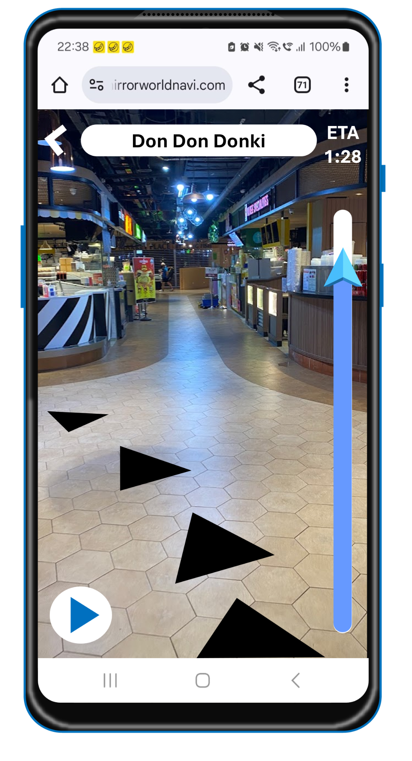
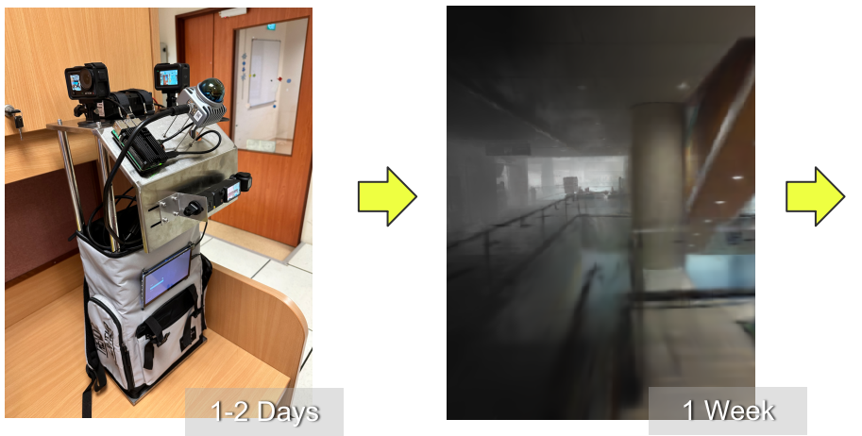
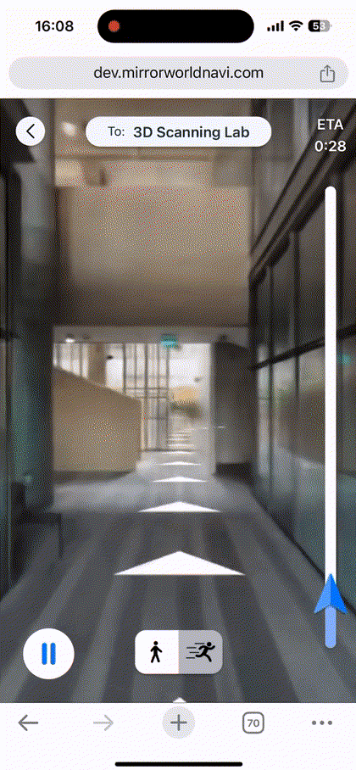
Mirror World 3D Immersive Indoor Navigation
Scanning
Reconstruction
Navigation

Slide 3
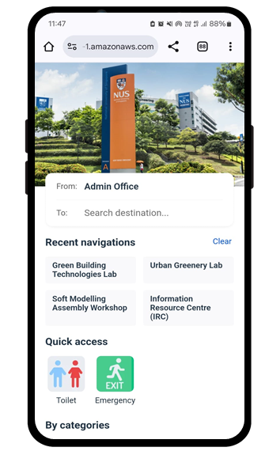






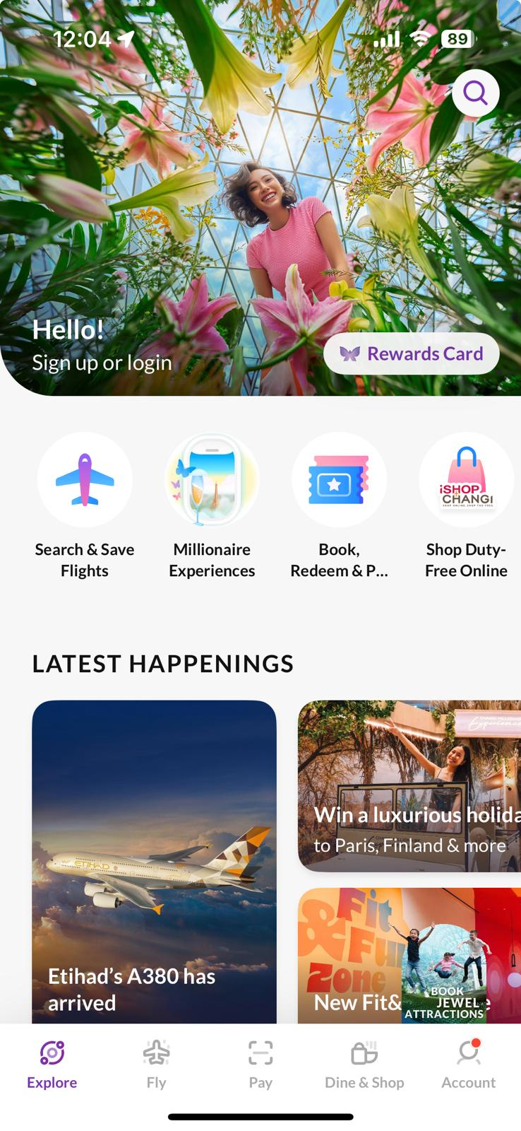
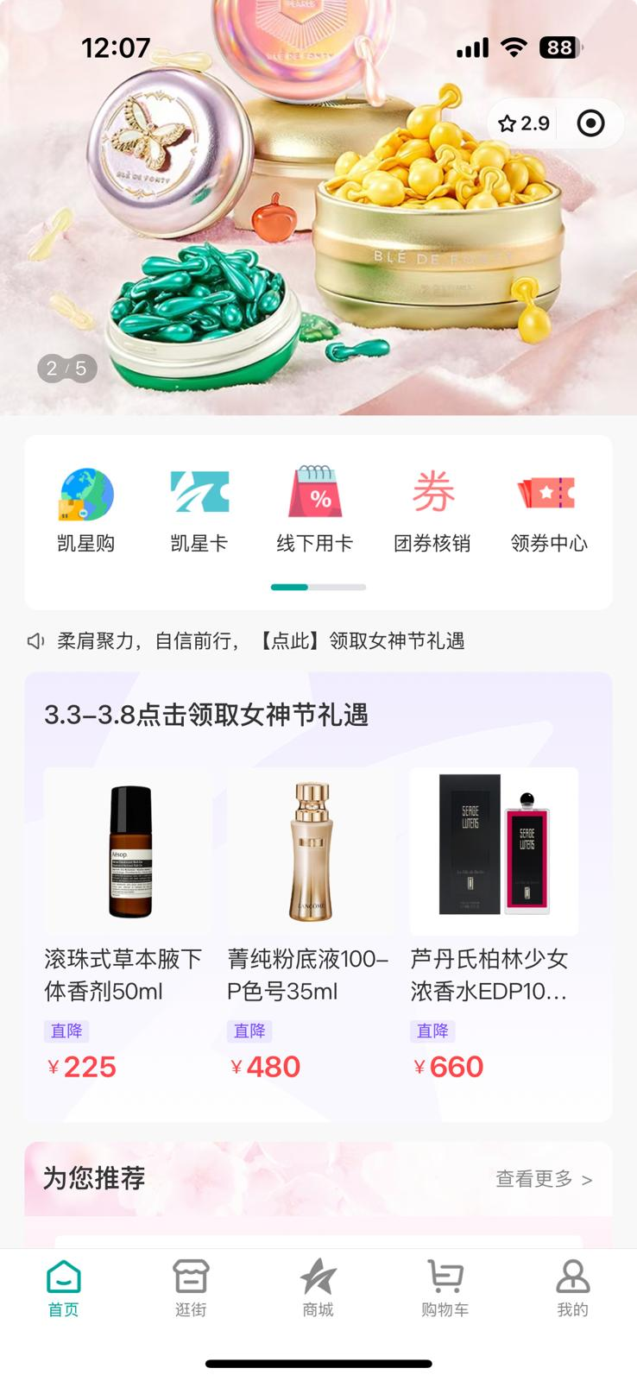

Mirror World 3D Immersive Indoor Navigation
No App Installation
Scan to Try
No Hardware
Intuitive Guidance
Indoor & Outdoor
1.Scan QR Code
or Access w/ Mall App
2.Choose Destination
3.Follow Navigation

Slide 4
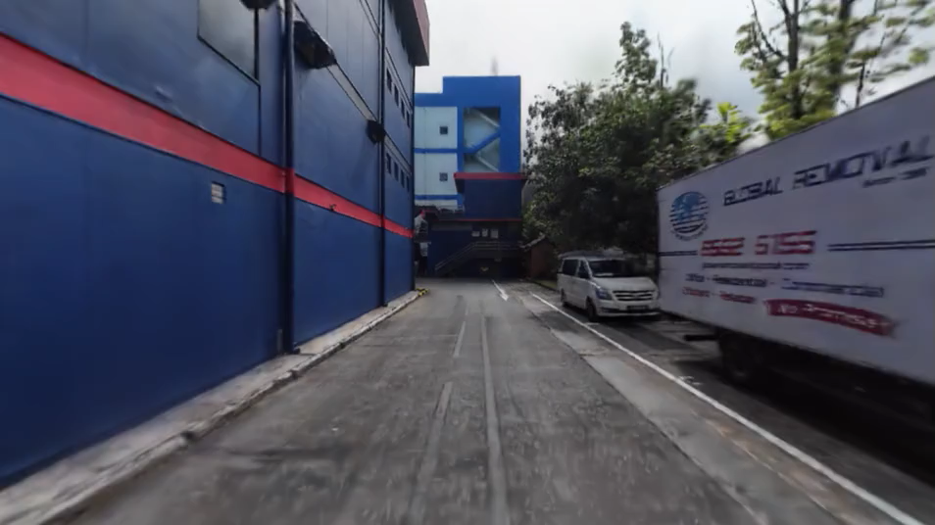
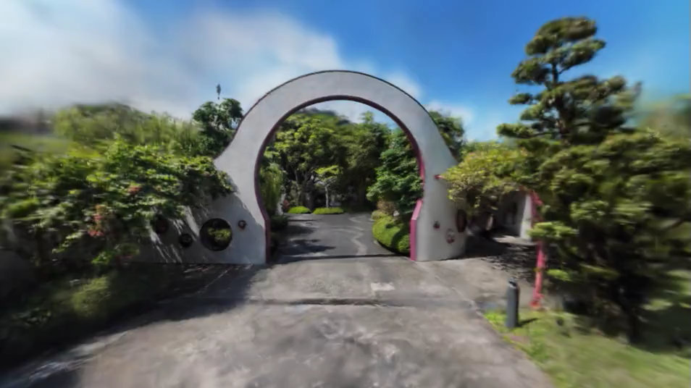
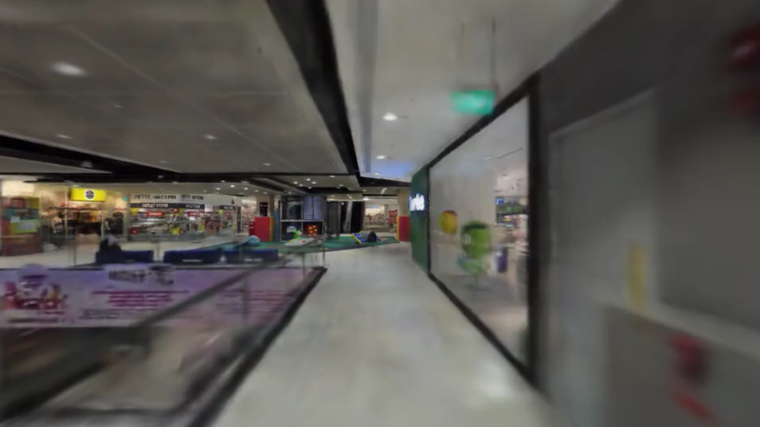
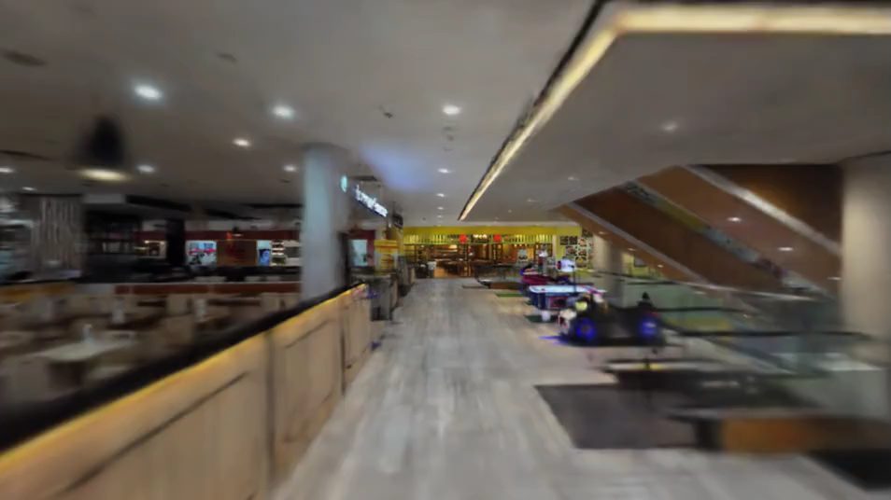
Mirror World 3D Immersive Indoor Navigation
Outdoor
Outdoor
Indoor
Indoor

Slide 5







Mirror World 3D Immersive Indoor Navigation
NUS - Pilot Finished
Working on Commercials
to Scale
RCCQ Mall (CN) Scoping POC with Customer Exp Team
Changi Airport (SG)
Finalizing Terms for
a Paid POC
SM Malls (PH)
Scoping POC with Wayfinding partner
ExtraSpace (SG)
Scan Complete
Delivering POC in Progress
NRF (SG, US, FR)
-Scoping POC with
Ops and Marketing Teams
TTSH (SG)
Scoping POC with COO, CDO and Innovation Team

Slide 6
Mirror World 3D Event Design Platform
Founder & CEO
NUS SoC VIP Team
National GRIP Final Round Team

Slide 7
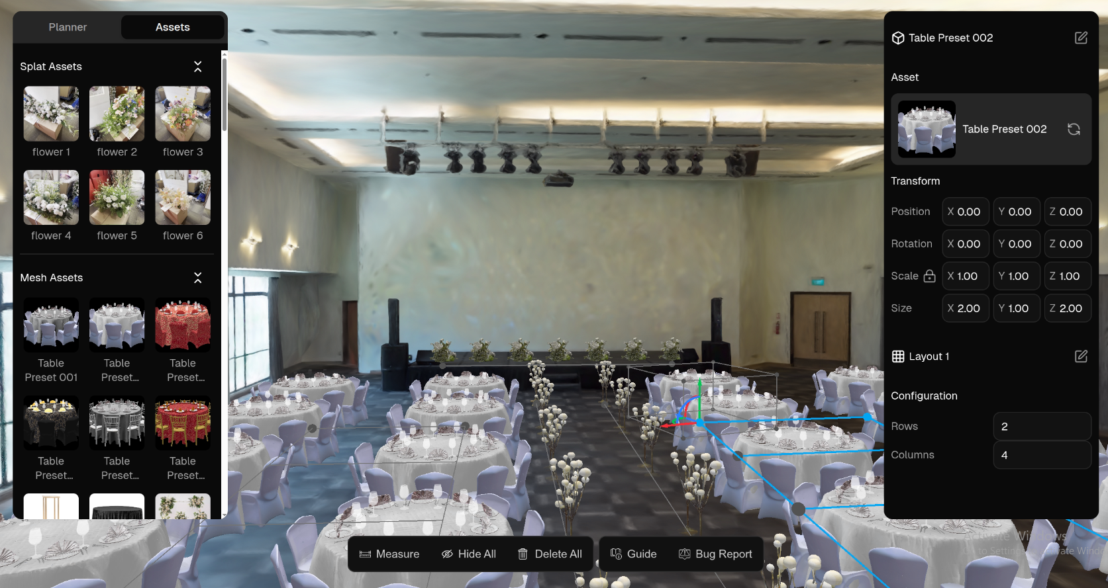

Mirror World 3D Event Design Platform
3D event design for weddings, MICE events, exhibitions…
Real-scale reconstruction
Photo-realistic visualization
Web editor with mixed 3DGS&Mesh representation
Fast image to 3D generation

Slide 8

Mirror World 3D Event Design Platform

Slide 9














Mirror World 3D Event Design Platform
Strategic Partners
Wedding Stylists
Venues
Boutiques
Penny Hustle
Décor Companies
Luna Bianca
We secured 15 LOIs with various partners

